Slide 1

Multimodal Time Series Exploitation and Notification via AI Agentic Workflow with LLMs
Present By: Zhiqi Ma, Bingqian Lu, Yangruonan Lin, Ruobing Zhang
Mentor Company: General Electric
Mentor Name: Liang Tang

Slide 2




GE aims to leverage LLMs for multimodal time series data analysis tasks.
Project Goal & Motivation
Replace traditional coding with natural language queries interaction using LLMs.
The project evaluates LLM capabilities in 4 time series tasks: threshold exceedance, slope calculation, forecasting, and text analysis.
Model Accuracy, Efficiency, Usability, and Privacy

Slide 3
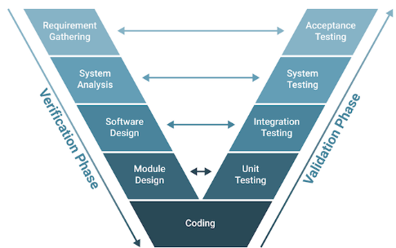
From:
To:
Requirements
Acceptance
{ Simple tasks;
Easy data exploitation;
fast prototyping;
Automatic pipeline}
Prompts
Testing
LLMs & Tools*
*Minimize coding

Slide 4
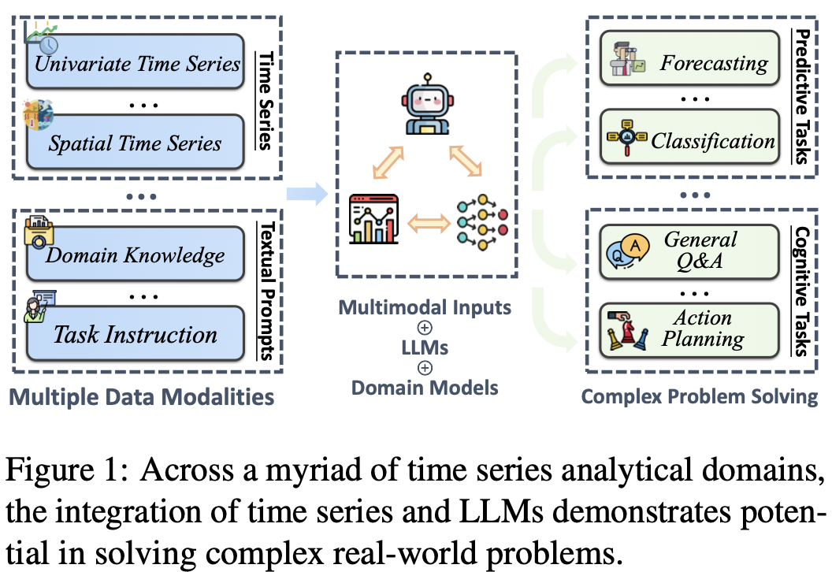
Existing Work and Background
Cite from: ‘Position Paper: What Can Large Language Models Tell Us about Time Series Analysis’

Slide 5
Literature Review on LLM For Time Series
- LLMTIME: Tokenize time series as text for zero-shot forecasting (used by last semester’s team)
- TIME-LLM: Use reprogramming & prompt-as-prefix (pap) to align time series with frozen LLMs
- TIME-MoE: Biggest TS foundation model w/ MOE, computationally efficient, forecasting with any length, achieves SOTA in many tasks
- CHRONOS: Amazon’s TS foundation model, Scaling & Tokenize time data as patch, train on T-5 LLM architecture; data augmentation strategy;
allow zero shot forecasting & user-defined fine-tuning
- TIMERAG: Segment & Cluster TS Data, Build Knowledge Base, Retrieval By Dynamic Time Warping (DTW)

Slide 6





Key Takeaways
on Current Work
Most Time Series LLMs/Foundation Models ONLY Focus On ONE TASK, mostly Forecasting
Promising For Time Series Forecasting
Few/none Works Explore General Time Series Analysis
Most DO NOT Provide Prompt-based (natural-language-like) User Interaction – ONLY Numerical Data ALLOWED – CANNOT DO Multi-Modal Analysis

Slide 7

Approach
4 Time series TASKS: Forecasting (predict future value); Threshold Exceedance (detect values cross threshold); Slope Calculation (determine rate of change over time interval); Text Analysis (identify maintenance based on text)
Data sources: Predictive Maintenance (PdM) dataset – operating conditions (volt, pressure, vibration, rotate) for 100 machines; machine maintenance history.
Other datasets from DARTS, MONASH, UCI ML REPO – cover various time frequency and application domain.

Slide 8
Dual-objective approach:
Explore cutting-edge LLM-based time series foundation models mainly for forecasting – Chronos by Amazon
Evaluate general LLM’s capability on time series tasks – OpenAI o3-mini, DeepSeek R1, LangChain Pandas Agent
Final Deliverable:
Brief Attempt of ‘AI agentic workflow’ & integrate all models into a single workflow
An LLM orchestrator assign task to respective model based on user request; can also convert user requests into Chronos operation mechanism (i.e. manually added prompt-interaction)
Built a GUI dashboard interface to visualize & automate the time series analysis process

Slide 9


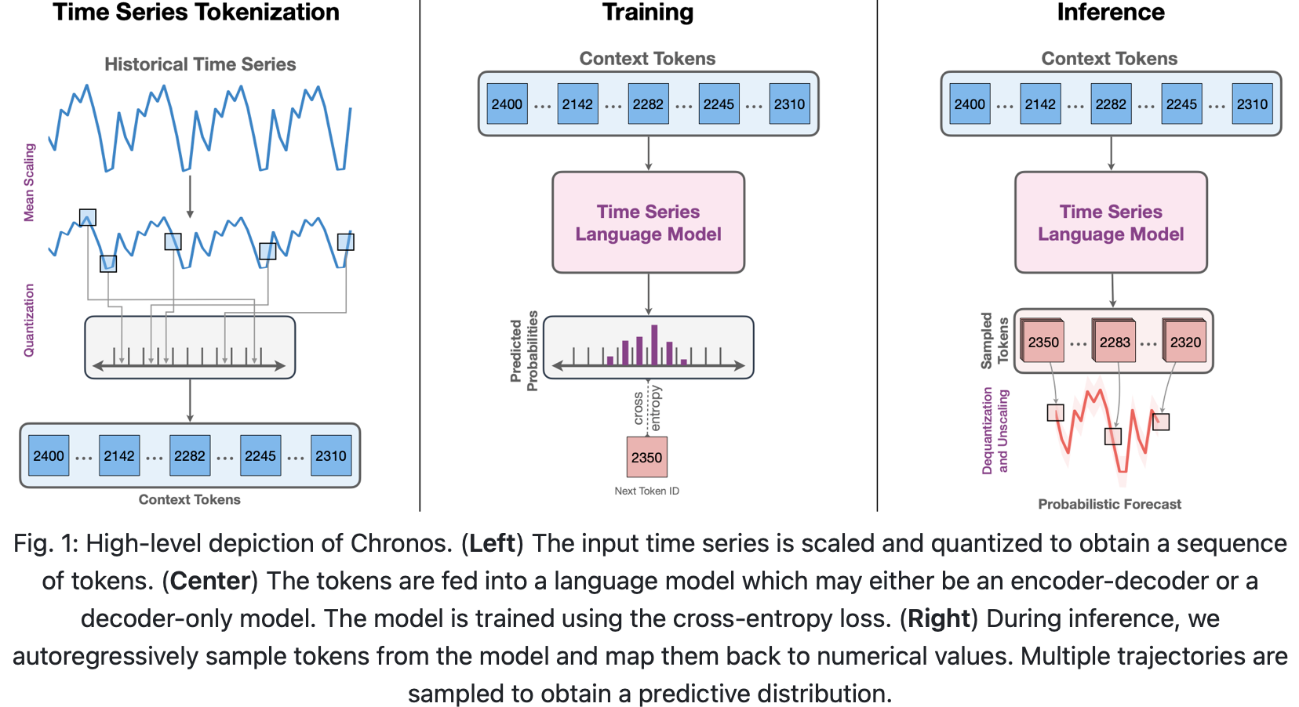
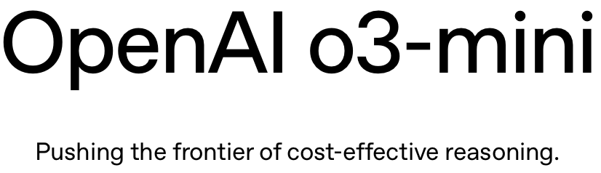

Cite from: model website for Gen LLMs and Chronos GIthub

Slide 10
What Does Success Look Like?
Key Performance Indicators (KPIs)
MAE, MAPE for forecasting;
MAE, MSE for slope calculation;
Accuracy for threshold exceedance & text analysis.
Computational efficiency ,cost, and usability of LLMs in an industrial workflow.
Business impact
Explore the usage of fore-front LLMs models & techniques in time series analysis tasks
Reduce manual effort in coding in industrial applications.

Slide 11
MODEL EVALUATION
Describe how to test each of 4 tasks (explain the difference between Chronos and others during evaluation); describe test data; evaluation metric
Explain test result for each task, each model, visualization and analysis
Model comparison; also compare with last semester team’s result
Notes:
In this section, we’ll discuss the evaluation process for our models for each task, then present and compare the model results.

Slide 12
How to Evaluate the Models?
Threshold Exceedance:
Data: 100 time series from PdM dataset, 25 each from: volt, rotate, pressure, vibration
Chronos first 900 points to forecast next 100, Count exceedance on forecasted points
Other LLMs Directly evaluate threshold from last 100 points of same series
Metric: Accuracy
Slope Calculation:
Data: same 100 time series as above, manually-modified linear trends for evaluation
Chronos first 900 points to forecast next 100, Compute slope via linear regression on forecasted points, Compare with ground-truth slope
Other LLMs Directly evaluate slope from last 100 points
Metric: MAE, MSE
Notes:
For both threshold exceedance and slope calculation tasks, we use 100 time series from predictive maintenance dataset on different machine variables, with slope added for slope calculation task for evaluation purpose.
Since Chronos model natively can only do forecasting, we first perform forecasting, then evaluate these 2 tasks on the predicted 100 data points;
while for other Gen LLMs models, they directly perform the tasks on those 100 data points.

Slide 13
Forecasting:
Data: 20 time series from PdM with varying length; 80 time series from DARTS & UCI ML, cover different domain and different time frequency with varying length
Models except LangChain Pandas Agent are evaluated on Forecasting: LangChain Pandas Agent cannot forecast.
Forecasting Length depends on data length:
Data length < 180: prediction length=24
180 ≤ Data length < 300: prediction length = 36
300 ≤ Data length < 1000: prediction length = 48
Data length ≥ 1000: prediction length = 100
Chronos supports Zero-shot and fine-tuned forecasting
OpenAI o3-mini & DeepSeek perform forecasting via user prompt
Metric: MAPE, MAE
Notes:
For forecasting task, the data covers different domains like energy, weather, retail, and finance; as well as different time frequency from 1 minute to 1 hour, 1 day, 1 week, and 1 month, with time series length from around 100 up to 10k.
LangChain Pandas agent cannot perform forecasting task so it’s not evaluated. and forecasting length depends on data lengths as it’s shown here.

Slide 14
Text Analysis:
Data: 100 text datasets generated by Deepseek based on PdM dataset, each contains 100 data points with columns including: Record ID, Machine ID, Date, and Description.
Motivation: let the LLMs categorize records based on text ‘Description’ to identify machines with maintenance conducted
E.g.:
‘Description’: ‘Hydraulic pressure levels consistent; system functioning correctly’ → no maintenance
‘Description’: ‘Electrical fuse replaced after power fluctuation incident’ → maintenance performed
LangChain Pandas Agent & DeepSeek are evaluated on this task
Metric: Accuracy
Notes:
text analysis task intends to let LLM to categorize whether a maintenance is performed on a machine based on machine record, as illustrated in the 2 examples here.
new task did in the past few weeks, only langchain and deepseek are evaluated

Slide 15
Threshold Exceedance (Chronos)
3 sizes of models are evaluated: Chronos Bolt base, Bolt small, and Bolt mini
zero-shot forecasting + threshold evaluation takes 2-4 mins for 100 test datasets
Bolt small & Bolt mini comparable performance: mean accuracy 97.5%, with Bolt small a little better;
Bolt base performs well for the first 50 time series (data with larger magnitude & more variations), with accuracy around 97~99%;
but relatively poor for the last 50 time series, with accuracy around 85~90%
Bolt base, with more parameters & more capable of capturing data pattern
→ for data with weak pattern / more noise, Bolt base may mistakenly interpret noise as meaningful pattern → bad results
Remember, we are still evaluating Chronos’ Forecasting capability – large model overfits on simple/small dataset!
Notes:
I’ll first present test results for Chronos on these tasks.
Chronos has 4 different pre-trained model sizes, here 3 of them are used for threshold task. as mentioned before, we do forecasting first then evaluate the threshold. the whole process takes 2-4 min for 100 tests, which is super fast.
Generally the performance is quite good, and each model can achieve a mean accuracy around 97 to 98%.
But bolt base seems to get poor results on some of test data.
Remember we’re actually still evaluating Chronos’s forecasting capability, so intuitively it’s because Bolt base overfits its predictions on dataset with weak pattern and more noise.

Slide 16
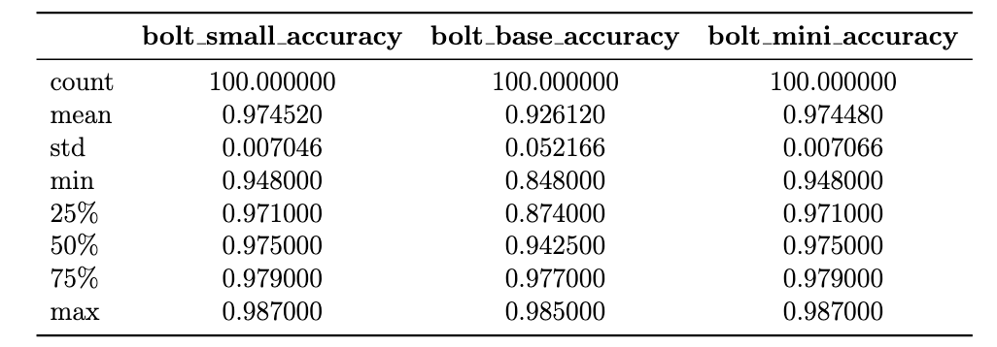
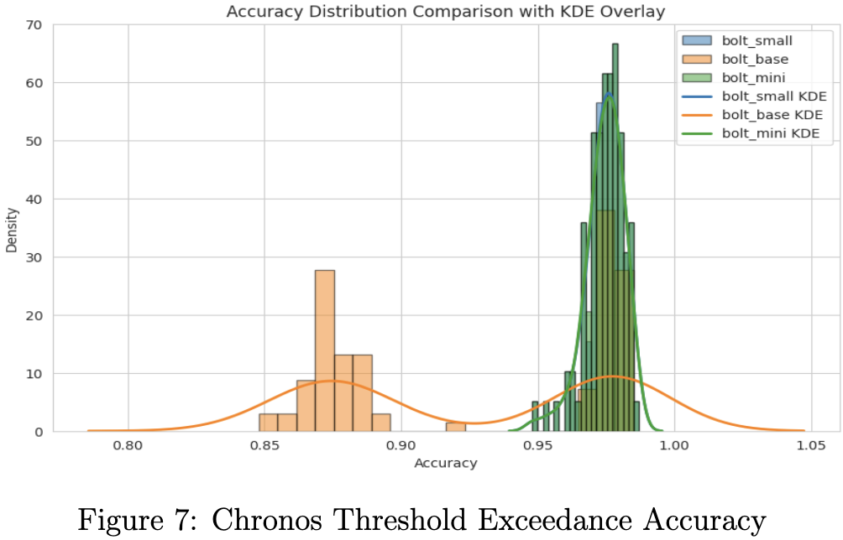

Slide 17
Slope Calculation (Chronos)
3 sizes models are evaluated: Chronos Bolt base, Bolt small, and Bolt mini.
zero-shot forecasting + slope evaluation takes 3-4 mins for 100 test datasets
slope calculation is more difficult than threshold exceedance
Bolt base much better → mean MSE 0.063, median MSE 0.024;
mean MAE 0.186, median MAE 0.155
Bolt mini a little worse → mean MSE 0.085, median MSE 0.039;
mean MAE 0.230, median MAE 0.199
Bolt small even worse → mean MSE 0.467, median MSE 0.432;
mean MAE 0.636, median MAE 0.657
Bolt mini: Fewer parameters, but sufficient to capture essential patterns
Bolt base: Much bigger, more powerful → effectively model complex trends
Bolt small: In-between size, struggle to balance complexity → worst performance
Notes:
While slope calculation is a more difficult task than the previous one. Again, it’s still super fast. But this time bolt base performs the best!
The reason is that since we manually add slope and noise to the original time series, the magnitude of data value becomes bigger and original pattern is magnified – now Bolt base shows its true power!

Slide 18
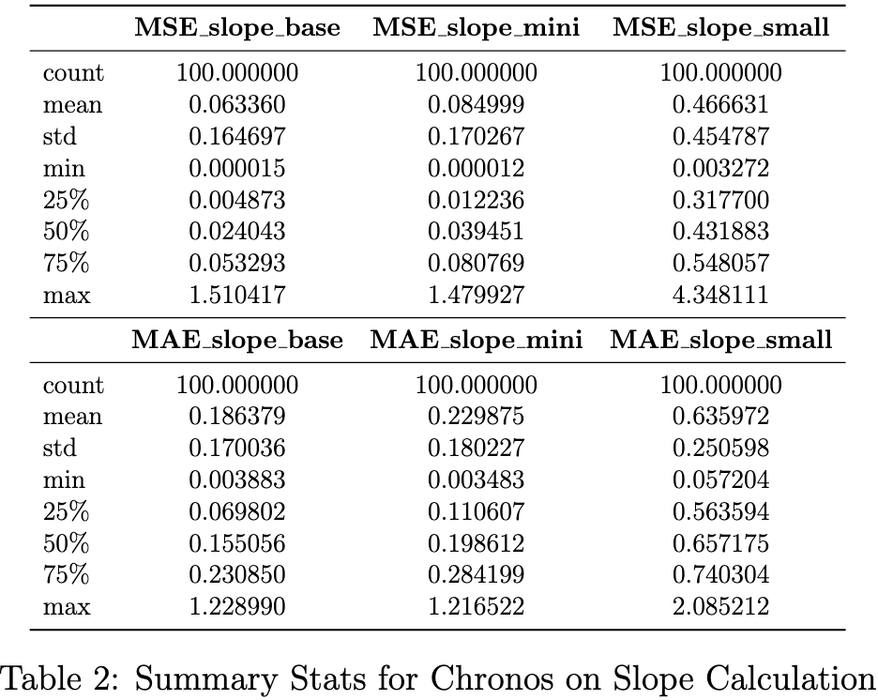
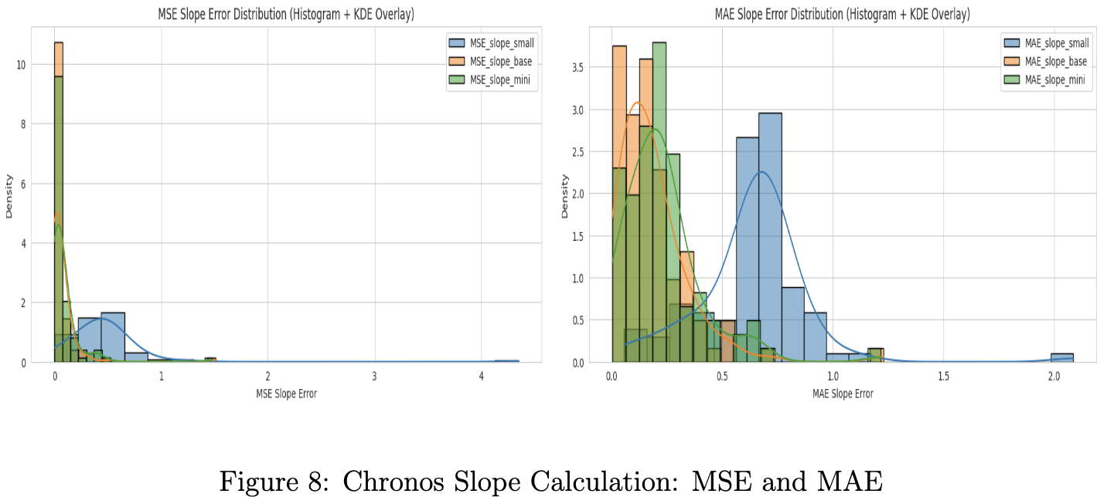

Slide 19
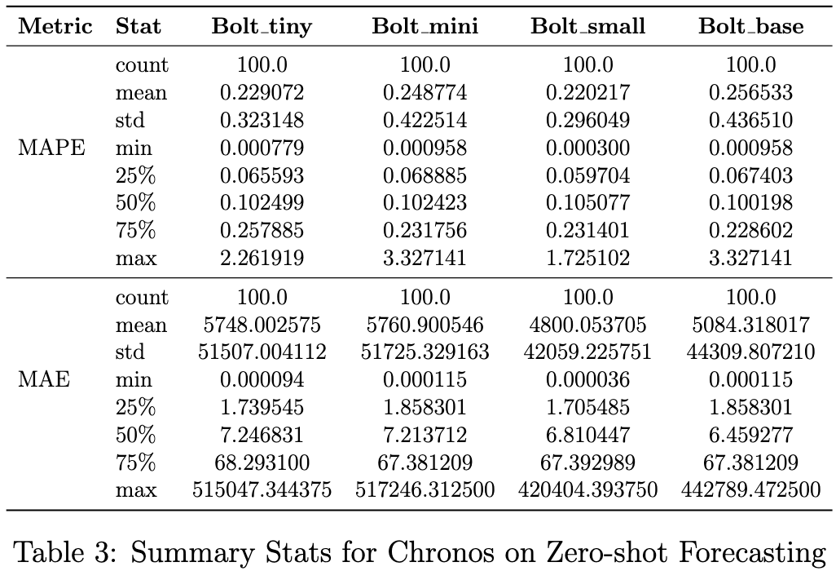
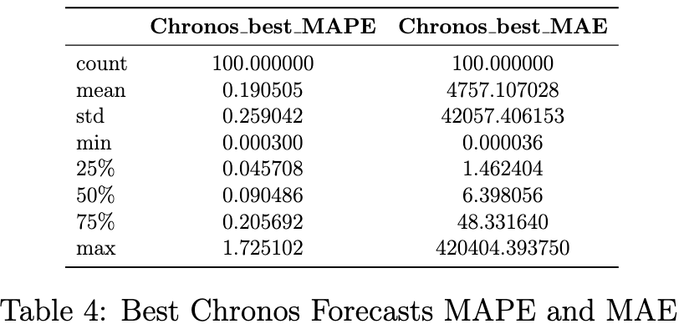
Forecasting (Chronos)
All 4 sizes models are evaluated: Chronos Bolt base, small, mini, tiny.
Zero Shot Forecasting: 6-8 mins for 100 test datasets
Fine-tuned Forecasting: manually set tuning parameters & time, 5 min/dataset
First 75% Quantile → all 4 models perform well; Mean error inflated by last 25% Quantile
Bolt Small: Most consistent performance
Bolt Base: Best 25%–75% performance, get worse in last 25%
About 35 datasets get better performance after fine-tuning, best performance collected.
Notes:
Finally when it comes to only forecasting, all 4 model sizes are evaluated on both zero-shot and fine-tuned forecasting, it takes about 6-8 min for zero-shot forecasting 100 data tests, while for fine-tuning we can manually set tuning parameters and time limit, here the result is tuning 5 min each dataset using CPU.
The result shows that, for the first 75% quantile of test result, all 4 models perform quite well, but the mean error is inflated by the last 25% quantile, which will be analyzed later.
Again, bolt base achieves the best performance for the first 75% quantile, while bolt small gives the most consistent result.
After fine-tuning, we see performance improvement in about 35 datasets.

Slide 20
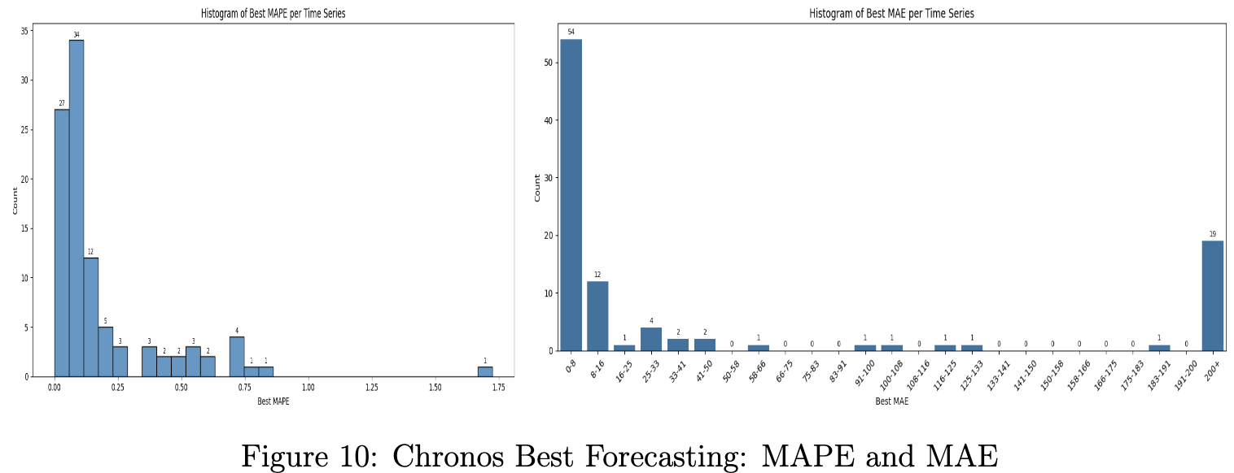
Why High Errors? (MAPE > 0.30 or MAE > 70)
Long series with high volatility
e.g., wind speeds (value 0.1~2) & solar power (value 300~5000), each 10000 data points
Long series with super large magnitude
e.g., electricity demand (value 30000~40000) 4000+ data
Short, super large, irregular series
e.g., wine sales (value 15000~40000) 176 data, wool production (value 3000~8000) 119 data
Short & irregular series with sudden outliers
e.g., sunspots (value mostly 40~50, suddenly to ~0 or ~160 with no pattern), 500 data
Lots of Missing values
e.g., # of patients: Chronos interpolates automatically, but may distort patterns
Notes:
Below list the distribution for the best result after fine-tuning for both MAPE and MAE, and we can clearly see there is a long-tail on both plots.
We’ve investigated the reason behind these bad result and concluded with 5 cases listed here:
it can be long series with high volatility, or time series with extremely large magnitude; it can also be due to too many sudden outliers or missing values, with examples also given in this page.

Slide 21
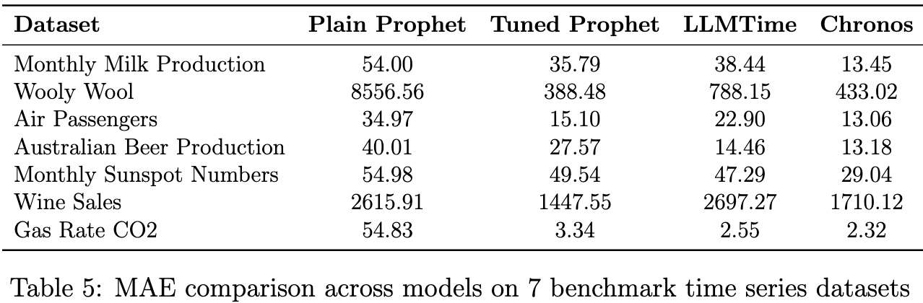
Chronos Forecasting vs. LLMTime
Chronos achieves lowest MAE on 5 out of 7 benchmark datasets
Dramatic improvement over LLMTime from previous team: MAE reduced by 2×–4× across all series
Tuned Prophet slightly better on: Wooly Wool and Wine Sales → Both are short, large-magnitude, and highly volatile series
Why Chronos underperforms in those cases?
Use probabilistic forecast & take median → conservative for highly volatile patterns;
due to large data magnitude, such a MAE difference is acceptable!
Fine-tuning Chronos is easier & similar to Deep learning model hyperparameter tuning
Notes:
plus, we also compare the result with previous semester’s team: they used fine-tuned prophet and LLMTime, another LLM-based time series model, and after comparison, Chronos achieved the best on 5 out 7 test sets with dramatic improvement across all of them.
for those 2 cases where Chronos underperforms: again as we just discussed in previous slide, it’s due to the large magnitude of data and chronos tends to give more conservative forecasting when situation is very unpredictable.
it’s also important to notice that it’s much easier to fine-tune Chronos, and it’s very like normal deep learning model’s fine-tune process, as we compare with fine-tuning Prophet, which requires domain expertise.

Slide 22
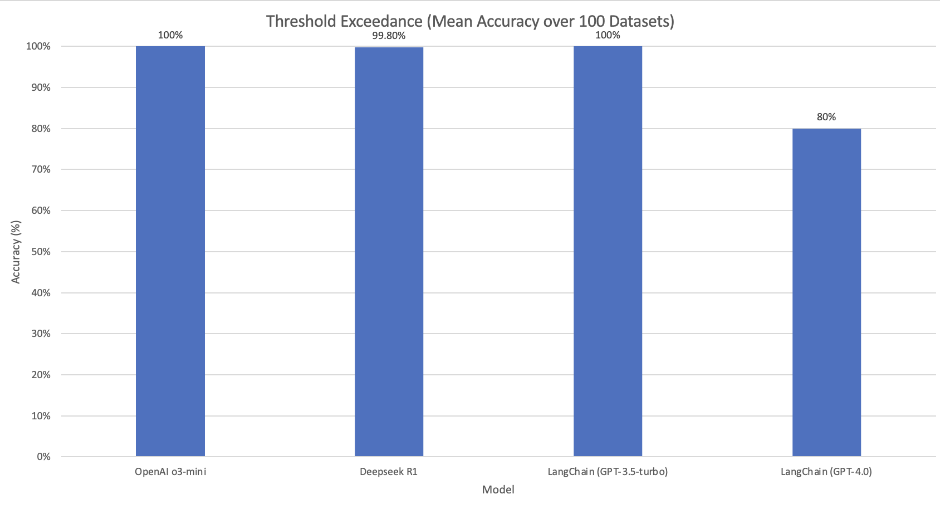
Threshold Exceedance (Gen LLMs)
o3-mini, DeepSeek, LangChain (GPT-3.5-turbo) perform better
Processing time:
o3-mini: 23 min
DeepSeek: 90 min
LangChain: 30 min
o3-mini & LangChain (GPT-3.5-turbo) win this task
Notes:
Here we compare threshold exceedance rates across different models on 100 datasets.
We can see that o3-mini and LangChain with GPT-3.5-turbo both hit 100% accuracy, while DeepSeek is very close.
However, DeepSeek takes much longer to run — about 90 minutes — compared to o3-mini and LangChain.
So although performance is similar, o3-mini and GPT-3.5-turbo are more efficient and win this task overall.

Slide 23
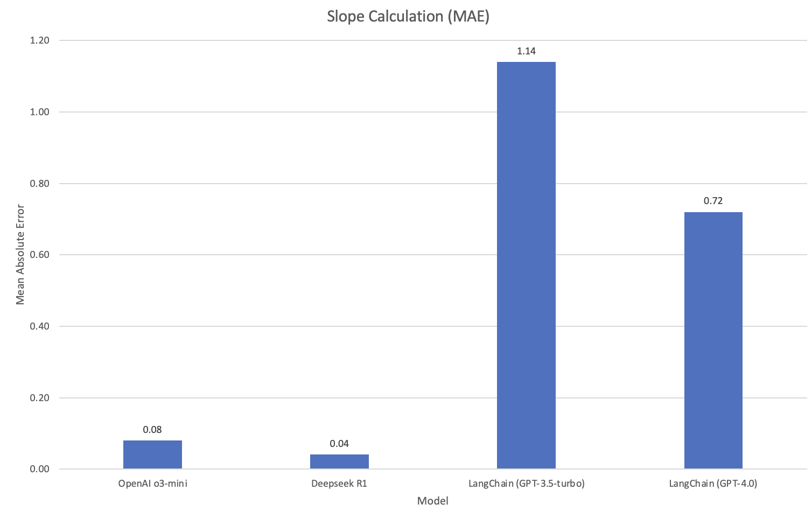
Slope Calculation (Gen LLMs)
o3-mini & DeepSeek perform best
But DeepSeek run over 15 hrs
vs.
o3-mini run 1.5 hrs
o3-mini wins this task
Notes:
For slope calculation task, we used mean absolute error to quantify models’ performance.
Both o3-mini and DeepSeek perform very well here — especially DeepSeek with the lowest MAE.
However, there's a huge gap in computing time — DeepSeek takes over 15 hours, while o3-mini finishes in just 1.5 hours.
So although DeepSeek has slightly better accuracy, o3-mini is far more efficient and is the clear winner in this task.

Slide 24
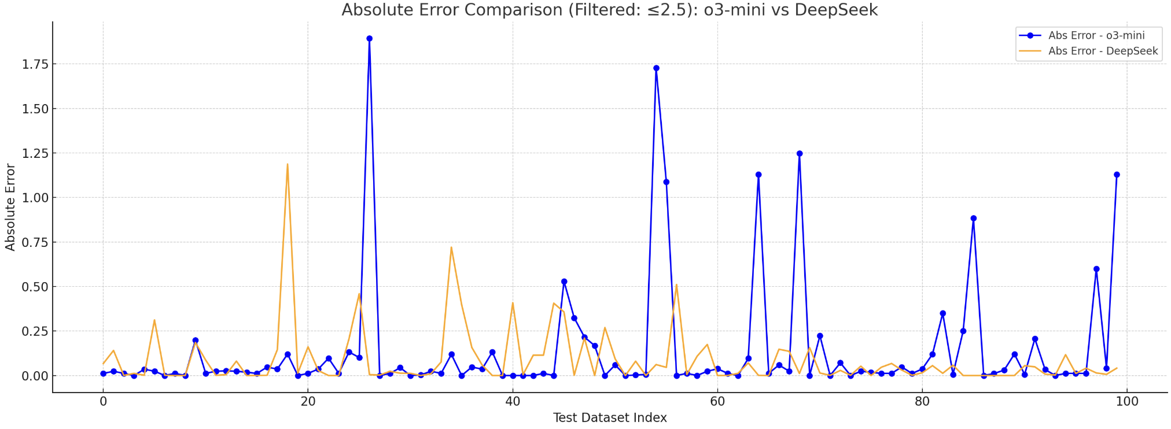
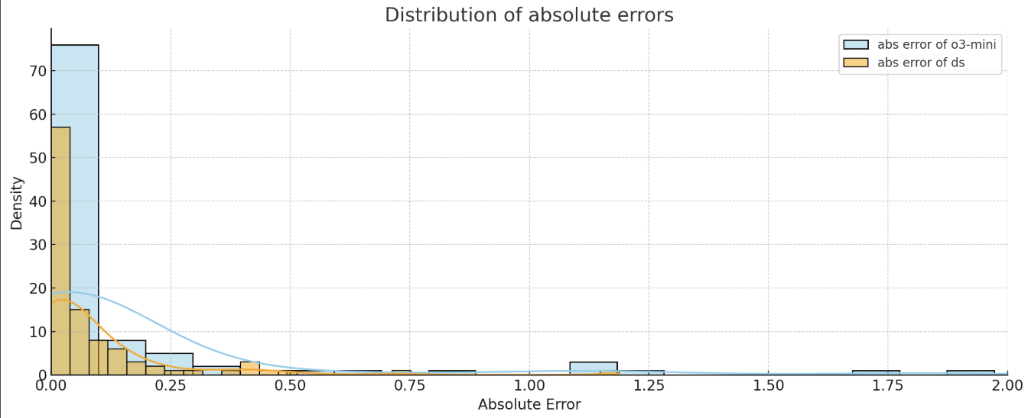
o3-mini’s issue:
unstable performance with frequent error spikes
less robust and more distributed in absolute error
acceptable given high efficiency
Notes:
However, there’s a key limitation of o3-mini — which is its unstable performance.
You can see frequent error spikes in the top line chart, especially compared to DeepSeek, which is more stable overall.
The bottom histogram also shows o3-mini's absolute errors are more widely distributed.
So although o3-mini is less robust, the trade-off is its speed and efficiency, which may still make it a practical choice depending on the use case.

Slide 25
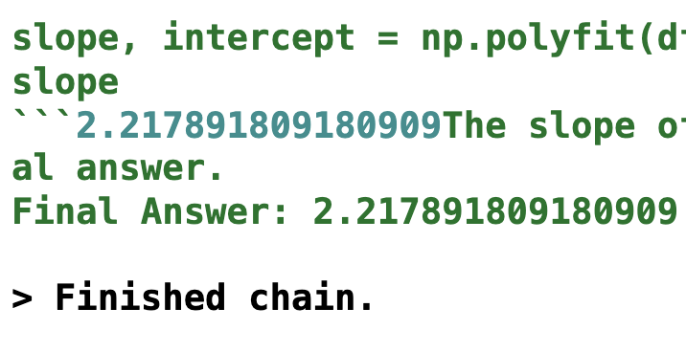
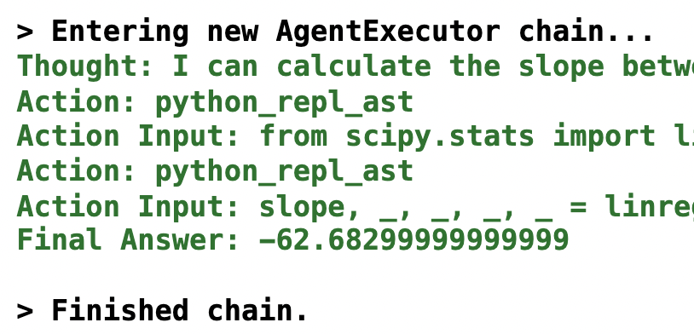
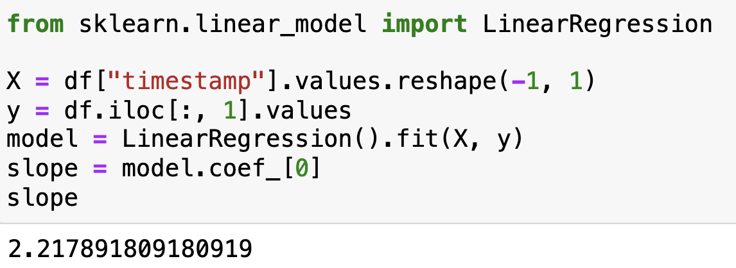
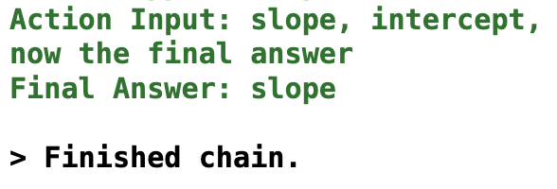
LangChain Normal Performance
LangChain Deviant Performance
LangChain Agent Result:
1. Extreme/Impossible Value
The slope range should not exceed 3.
The slope should not be negative in this dataset.
Ground Truth by Python
2. Return a string rather than numerical value
The answer is an exact match to at least 6 digits after the decimal point
The returned value is the variable name, which stores the actual value for slope.
Notes:
For LangChain, besides its relatively worse performance, the model is really unstable given 100 datasets. The slide shows our observations when running all 100 datasets.
On the left, we see a correct execution — the LangChain agent gets a result that exactly matches Python’s ground truth, even at the decimal level.
On the right, however, we observe two types of failure cases.
First, it produces an extreme value, which is not only out of the expected range but also incorrectly negative for this dataset.
Second, it sometimes returns the variable name ‘slope’ as the final answer — instead of the actual number.
These cases highlight issues with execution stability and response parsing in LangChain’s agent behavior.

Slide 26
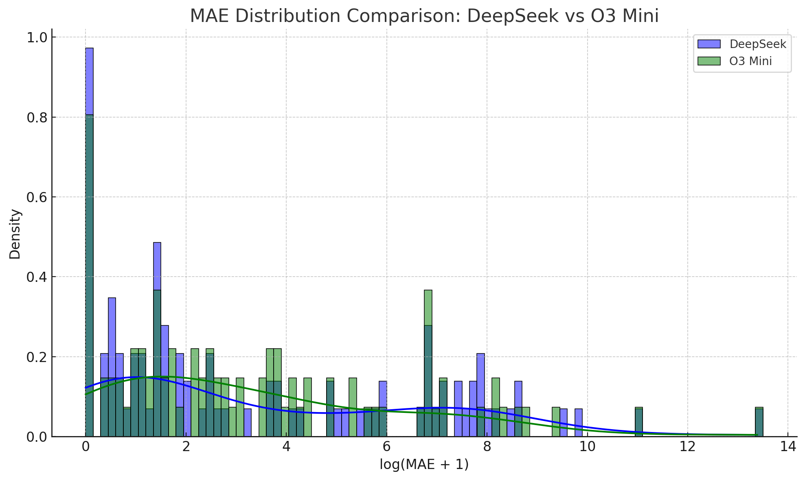

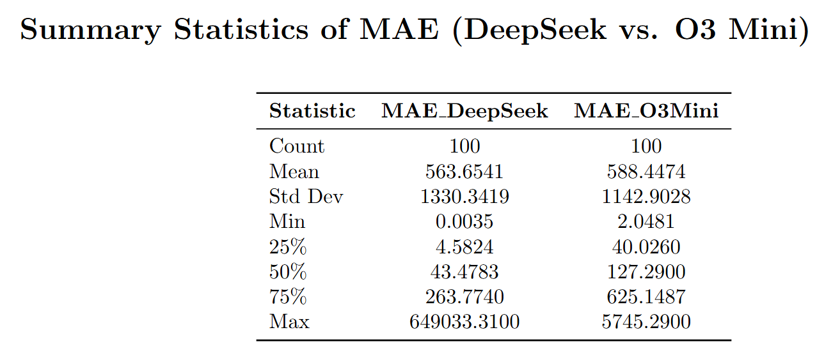
Forecasting(Gen LLMs)
Processing time:
DeepSeek: 8 hrs
o3-mini: 2.5 hrs
Both models perform badly in forecasting
o3-mini more consistent results
Chronos best suited for forecasting
Notes:
For forecasting task, we mainly compared performance of DeepSeek and o3-mini, measured by MAE distribution.
Unfortunately, both models perform poorly overall — we can see wide error distributions and very high max values.
o3-mini is slightly more consistent, with lower standard deviation and tighter clustering in the lower MAE range.
But neither model is reliable for this task — DeepSeek even hit a max MAE over 640k.
Also, DeepSeek took 8 hours to run, while o3-mini finished in just 2.5 hours.
So overall, LLMs are not suited for forecasting. For this task, a specialized model like Chronos is much more appropriate.

Slide 27
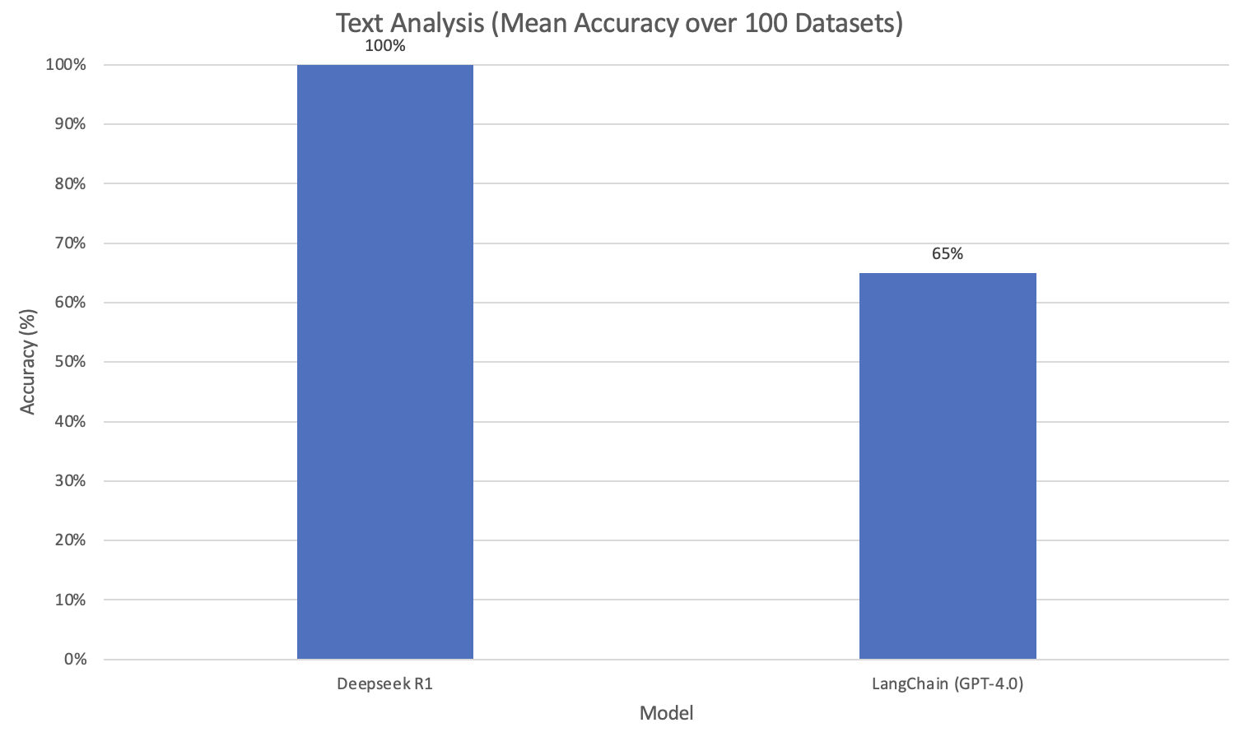
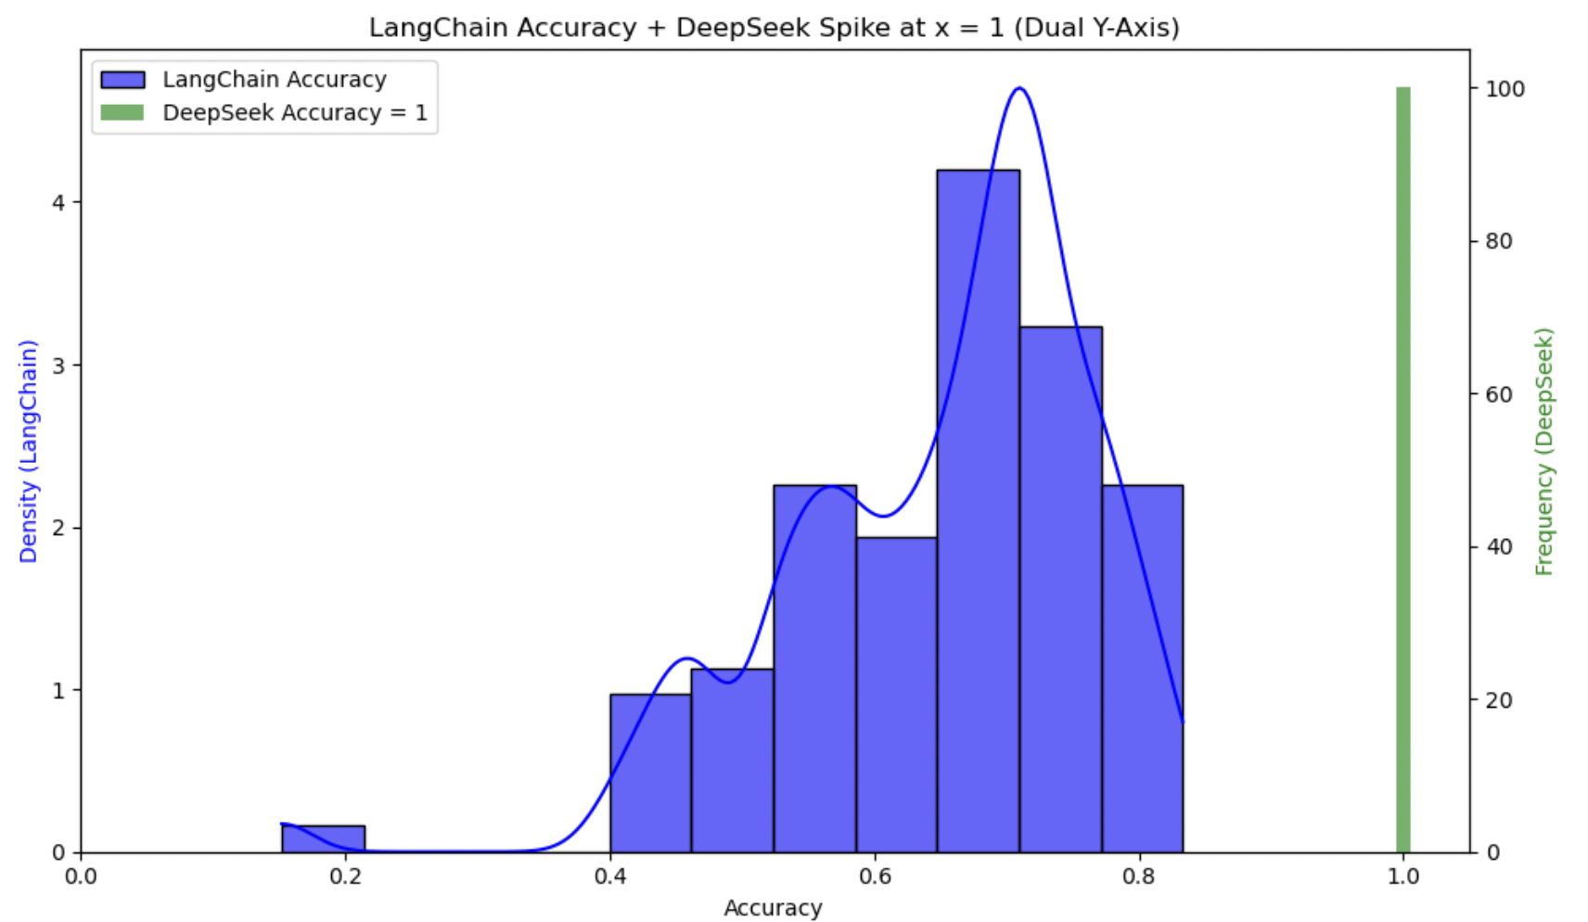
Text Analysis(Gen LLMs)
Comparable processing time
DeepSeek shows strong and robust text analysis ability
LangChain problem: high variation when running 100 datasets together
Notes:
For text analysis, we compared the accuracy of DeepSeek and LangChain.
DeepSeek achieves perfect accuracy across all 100 datasets — shown by the green spike at 1.0 on the right.
In contrast, LangChain only reaches about 65% accuracy, with much higher variance in its predictions.
The blue histogram shows LangChain's results are widely spread and inconsistent across datasets.
Even though both models have similar processing time, DeepSeek clearly outperforms in both accuracy and stability.

Slide 28
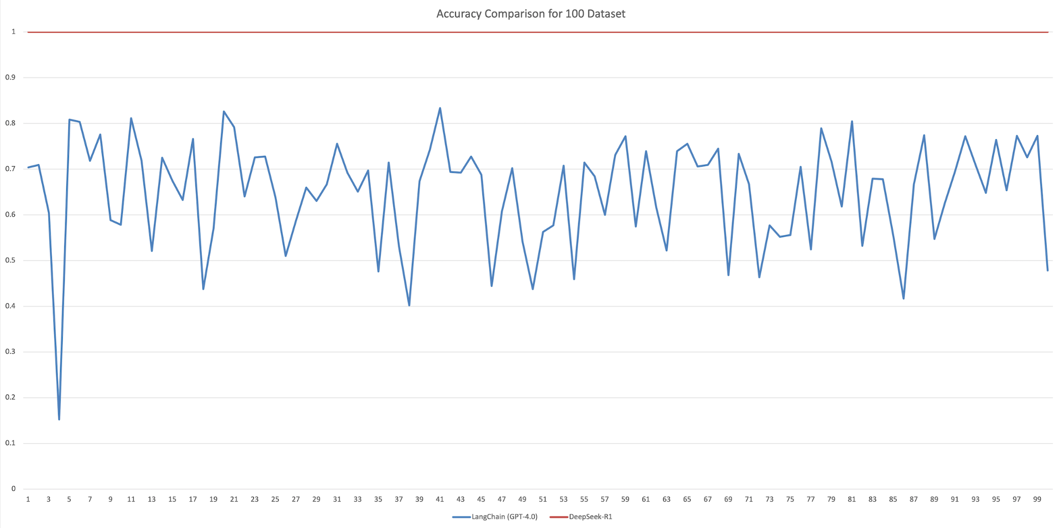
Notes:
And here you can more clearly see how unstable LangChain is.

Slide 29
WHY Agentic Workflow?
Chronos does not support natural language input / prompt interaction.
Different models suited for different tasks
Need for a unified interface to manage task execution and model routing.
Follow the high-level goal to minimize manual effort & reduce coding
Goal: enable natural language prompts to trigger correct models and tasks automatically.
Notes:
Now we’ve finished the model evaluation section, but there is remaining issue, especially for Chronos, since it cannot let users interact via natural language prompts.
Following this goal, we explored the Agentic workflow, which solves this issue, as well as to integrate multiple models we used into one unified workflow.

Slide 30
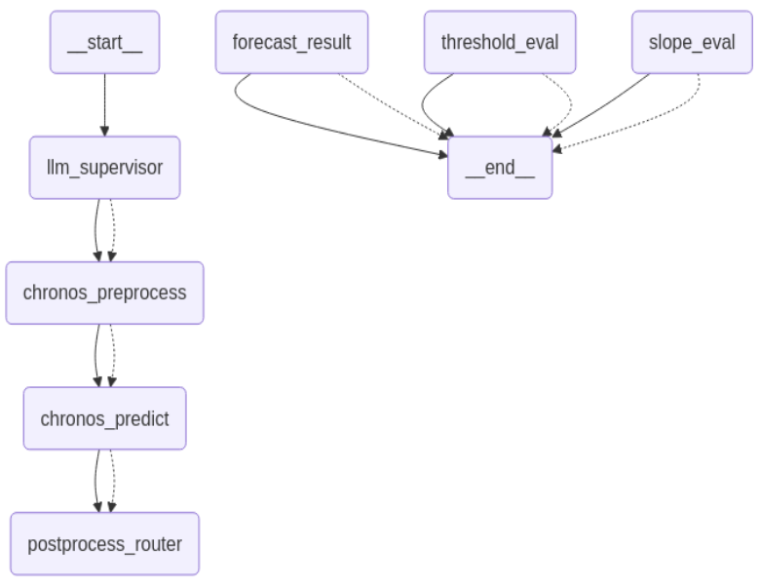
Agentic Workflow 1: Chronos-Based
Fully automate time series analysis using Chronos
Triggered by user natural language prompt
Support 3 tasks via forecast-then-evaluate structure:
Forecasting
Threshold Exceedance (based on predicted points)
Slope Calculation (based on predicted slope)
Workflow Nodes:
LLM Supervisor: GPT-4 to classify task from prompt
Chronos Preprocess: load & format time series
Chronos Predict: run Chronos forecasting
Postprocess Router: dispatch forecasting result to task-specific evaluators and generate output
Notes:
We mainly constructed 2 agentic workflow, this is the first one while solely relies on Chronos to perform these 3 time series tasks previously discussed, the point is now users can use natural language prompts to invoke Chronos and task router will assign the request to corresponding task node, as the workflow shows.

Slide 31
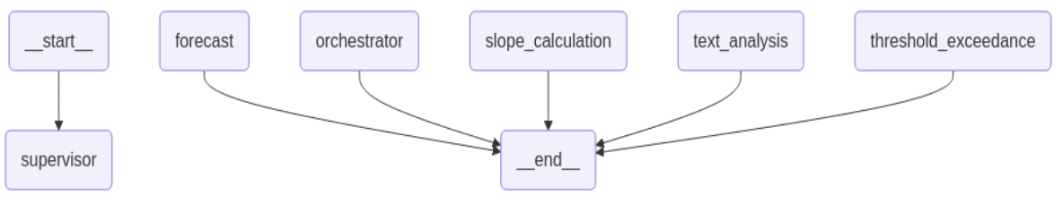
Agentic Workflow 2: Multi-Agent
Combine Chronos, LangChain Pandas Agent, and OpenAI o3-mini
Powered by GPT-4 Supervisor Node:
Natural language prompts & trigger multiple tasks
Support prompt decomposition for multi-task input prompt
Tasks:
Forecasting → Chronos (package everything into a single ‘forecast’ node)
Threshold / Slope → LangChain Pandas Agent (GPT-3.5 Turbo & GPT-4)
Text Maintenance Analysis → OpenAI o3-mini
Multiple Tasks in 1 prompt → ‘orchestrator’ node (LangChain Pandas Agent)
→ Seperate the task & reroute them to supervisor node
for dispatch
Notes:
In the second workflow, we combine multiple models together, again it’s triggered by natural language prompt, and the task will be assigned to respective node given user requests. additionally, there is an orchestrator node that can split the prompt into sub-prompts if it contains multiple tasks, as shown in the next slide.

Slide 32
Interactive GUI: Agentic Workflow Demo
Built with Gradio, offering a user-friendly frontend for our LangGraph backend
Allow users to interact with time series agents without coding
Notes:
What’s more? we also build a simple interactive dashboard GUI for the multi-agent workflow! users can upload the time series and text files they want to analyze, select task, select the forecasting length, and download the predictions if they need.

Slide 33
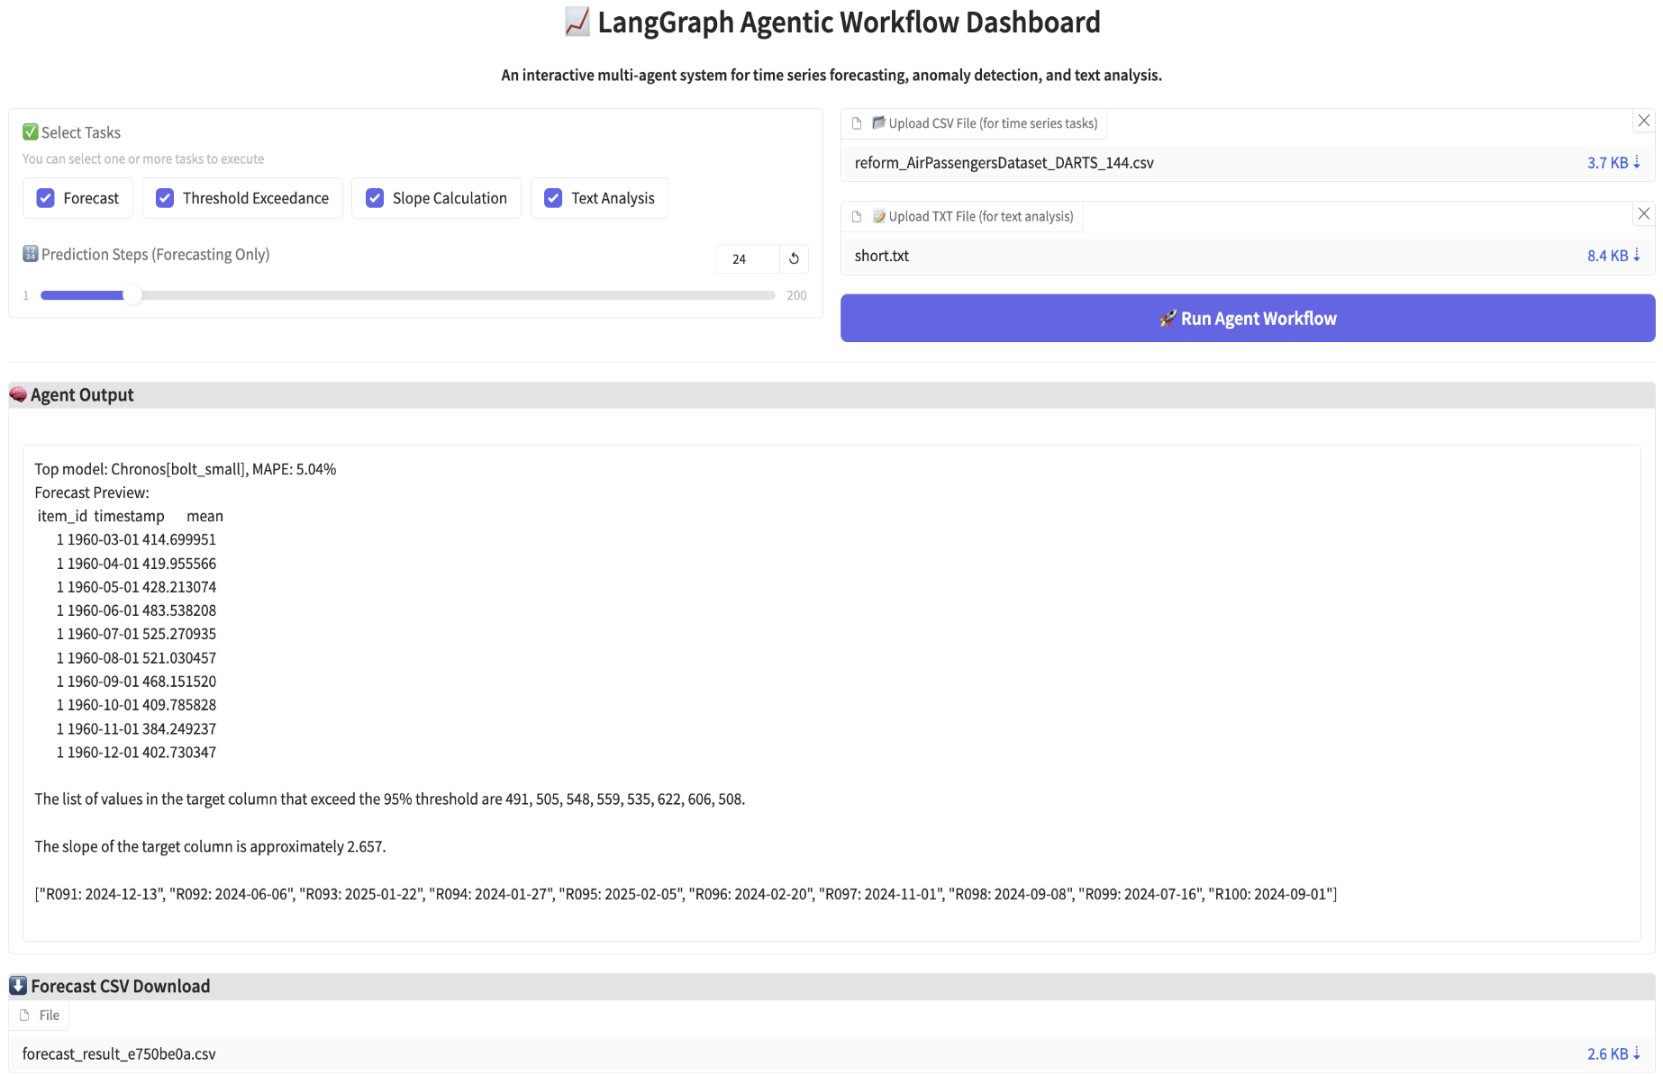
Example: How to
use the
GUI?
Notes:
Available functions include:
Upload .csv / .txt files to analyze
Select task (forecast, slope, threshold, text), single/multiple task
Select forecasting length
Download forecasting results
System interprets user input selection and routes to corresponding agent

Slide 34
CHALLENGES & NEXT STEPS
Conclusion:
Gen LLMs: effective in general time series analysis except forecasting
TS Foundation Model: model like Chronos is powerful, effective, and efficient in a particular time series task – e.g. forecasting
Agentic Workflow: leverage LLMs’ power, manage task execution, orchestrate multiple models/tools, simplify pipeline, and reduce coding!
Challenges:
Computation Inefficiency: Gen LLMs struggle with large-scale numerical calculations
Instability: LangChain Pandas experiences unstable task execution
Prompt Sensitivity: Small changes in phrasing significantly impact model performance.
Next Steps:
More Explainable LLMs Model, More Intelligent Agentic Workflow, and More Adaptable GUI
Notes:
In conclusion, we still have some challenges and things need to do in the future. Concisely, it’s about computation inefficiency, performance instability, and prompt sensitivity.
Plus, we also need to improve the explainability of these LLMs model, as well as building more intelligent agentic workflow and more adaptable GUI.

Slide 35


Slide 36


What’s AI Agent & Agentic Workflow?
AI Agent:
An autonomous system powered by LLM — interpret high-level instructions and perform tasks through reasoning, tool usage, and data operations.
Agentic Workflow:
A modular architecture — use routing mechanism and multiple agents/tools; coordinate & execute complex tasks automatically
Our Implementation:
Built on LangChain & LangGraph
LangChain: LLM integration, tool execution
LangGraph: Advanced orchestration framework for complex & extensible AI agentic systems
Chronos integrated manually, not natively supported by LangChain/LangGraph ecosystem
+
Notes:
There are lots of different interpretations for AI agents, we showed one here – basically it relies on an LLM to deal with users’ instructions via prompts and an agentic workflow connects multiple agents to solve more complex and diverse problems.
We used LangChain and LangGraph platform to build the workflow, for Chronos, we need to define how the agent should work from scratch as it’s not originally integrated into this ecosystem.

Slide 37
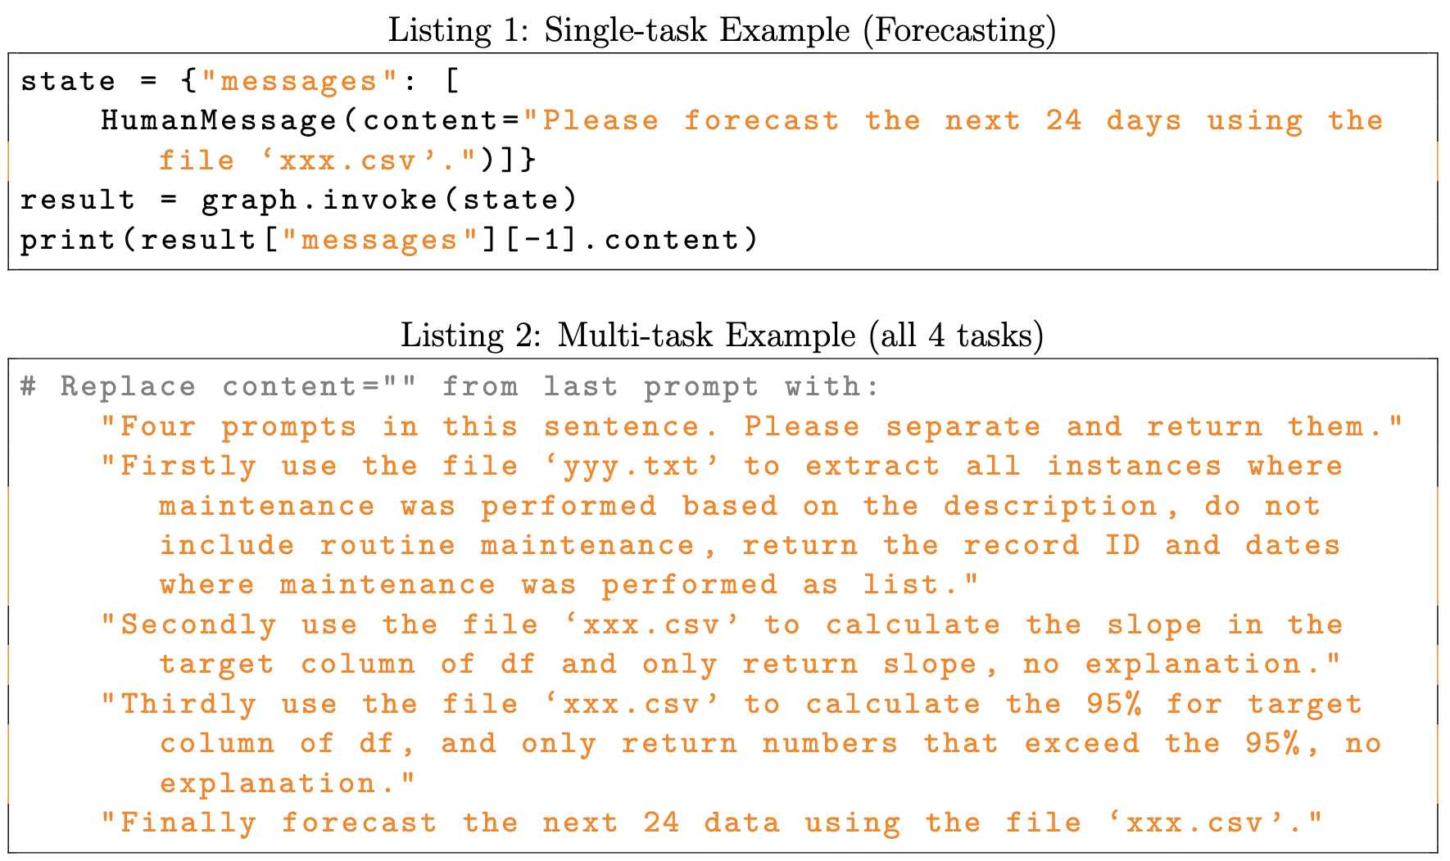
Example: How to
Invoke the Workflow?
Notes:
Here we show how to invoke the multi-agent workflow in both single-task case and multi-task case

Slide 38
WHY Agentic Workflow?
Chronos does not support natural language input / prompt interaction.
Different models suited for different tasks
Chronos: best for time series forecasting
LangChain Pandas Agent: fast & effective in general time series analysis
GPT o3-mini / DeepSeek: strong at text analysis and numerical reasoning
Need for a unified interface to manage task execution and model routing.
Follow the high-level goal to minimize manual effort & reduce coding
Goal: enable natural language prompts to trigger correct models and tasks automatically.
Notes:
Now we’ve finished the model evaluation section, but there is remaining issue, especially for Chronos, since it cannot let users interact via natural language prompts.
Following this goal, we explored the Agentic workflow, which solves this issue, as well as to integrate multiple models we used into one unified workflow.

